Slide 1
ENCRYPTING CREDIT CARD FRAUD AND CUSTOMER ACTIVATION PREDICTION WITH MACHINE LEARNING
Under the Guidance for
Dr.R. THIRUMALAI SELVI M.Ss., M.phil., PhD.
Presented By
JAYAKANTHAN.A
2313112078010
M.Sc. Computer Science

Slide 2
Abstract
In the modern financial ecosystem, ensuring the security of credit card transactions and enhancing customer activation strategies are paramount. This paper explores the application of machine learning techniques to predict credit card fraud and customer activation, with a focus on incorporating encryption methodologies to safeguard sensitive data.
By leveraging advanced algorithms, our models achieve high accuracy in identifying fraudulent activities and predicting customer engagement. The integration of these predictive models within the Django framework facilitates a robust and scalable web application, ensuring seamless deployment and user accessibility.
This approach not only enhances data security through encryption but also empowers financial institutions with actionable insights, promoting both fraud prevention and customer retention.
Keywords: Credit Card Fraud Detection, Customer Activation Prediction, Machine Learning, Django Framework, Web Application Development

Slide 3
Existing System
With the flourishing of the credit card business and Internet technology, the risk of fraudulent credit card transactions is ever-increasing due to the complex information involved in the credit card business. Since the high redundancy of feature information and imbalance of class distribution in transaction data, the performance of the existing machine learning-based models for detecting credit card fraudulent transactions still needs to be improved.
Therefore, it is crucial to build fraud detection models for effective feature engineering and sampling techniques. This article proposes a credit card fraud detection model incorporating a fraud feature-boosting mechanism with a spiral oversampling balancing technique (SOBT). Specifically, we present a compound grouping elimination strategy to exclude highly redundant and correlated features from the credit card transaction dataset and improve the data quality.
Furthermore, we design a multifactor synchronous embedding mechanism, which combines the performance evaluation metrics of the embedding model for each feature and improves the decisionmaking ability of each feature for the target domain. Moreover, we propose an SOBT to balance the ratio of legitimate to fraudulent transactions, which improves the ability of the fraud detection model to distinguish legitimate from fraudulent transactions. Extensive experimental results based on two real-world datasets demonstrate that our methods can facilitate efficient credit card fraud detection and achieve better performance than state-of-the-art methods

Slide 4
DEMERITS
Computational Complexity
Overfitting Risk
Complexity of Implementation
Scalability Issues
Imbalance Handling Limitations
They are didn’t using web applications.

Slide 5
Proposed System
The proposed system aims to enhance the security and accuracy of credit card fraud detection and customer activation predictions using machine learning models integrated within a Django framework. The system involves the development of robust predictive models trained on historical transaction and customer behavior data to identify potential fraud and predict customer activation.
To ensure the confidentiality and integrity of the predictions, the system employs advanced encryption techniques. Sensitive data, including user inputs and model outputs, are encrypted using industry-standard cryptographic algorithms. The encrypted data is securely stored and transmitted, preventing unauthorized access and tampering.
The Django framework serves as the backbone of the system, providing a scalable and flexible environment for deploying and managing the machine learning models. It facilitates seamless integration with databases, handling of user authentication, and implementation of security protocols. By leveraging Django's robust features, the system ensures efficient processing, real-time predictions, and secure communication channels between different components.

Slide 6
Advantages
We build a framework based application for deployment purpose.
We implemented balancing in the dataset in our project
High scalability.
We are implemented compare the algorithms.
High level accuracy.
The modular nature of Django enables easy updates and maintenance

Slide 7
Scope of the Project
The scope of the project "Encrypting Credit Card Fraud Predictions with Advanced Machine Learning" encompasses developing a comprehensive system that utilizes cutting-edge machine learning techniques to enhance the security and accuracy of credit card fraud detection.
This project aims to integrate advanced algorithms, such as Convolutional Neural Networks (CNNs) and ensemble methods, to analyze transaction data and identify fraudulent activities with high precision.
The system will incorporate encryption mechanisms to ensure that sensitive financial information is protected throughout the prediction process. Additionally, the project will involve the design and implementation of a secure data pipeline, a user-friendly interface for monitoring and managing fraud predictions, and robust evaluation metrics to assess the effectiveness of the fraud detection models.
The ultimate goal is to provide a scalable and reliable solution that can be deployed in real-world scenarios to mitigate the risks associated with credit card fraud, while safeguarding user privacy and data integrity.

Slide 8
LIST OF MODULES
Data Pre-processing
Data Analysis of Visualization
Adaboost classifier algorithm
Decision Tree algorithm
K Neighbors Classifier
Extra Trees classifier
Model Building
Deployment

Slide 9
MODULE DESCRIPTION
Data Pre-processing:
Validation techniques in machine learning are used to get the error rate of the Machine Learning (ML) model, which can be considered as close to the true error rate of the dataset. If the data volume is large enough to be representative of the population, you may not need the validation techniques.
However, in real-world scenarios, to work with samples of data that may not be a true representative of the population of given dataset. To finding the missing value, duplicate value and description of data type whether it is float variable or integer. The sample of data used to provide an unbiased evaluation of a model fit on the training dataset while tuning model hyper parameters.

Slide 10
Exploration data analysis of visualization
Data visualization is an important skill in applied statistics and machine learning. Statistics does indeed focus on quantitative descriptions and estimations of data. Data visualization provides an important suite of tools for gaining a qualitative understanding. This can be helpful when exploring and getting to know a dataset and can help with identifying patterns, corrupt data, outliers, and much more. With a little domain knowledge, data visualizations can be used to express and demonstrate key relationships in plots and charts that are more visceral and stakeholders than measures of association or significance. Data visualization and exploratory data analysis are whole fields themselves and it will recommend a deeper dive into some the books mentioned at the end.
Sometimes data does not make sense until it can look at in a visual form, such as with charts and plots. Being able to quickly visualize of data samples and others is an important skill both in applied statistics and in applied machine learning. It will discover the many types of plots that you will need to know when visualizing data in Python and how to use them to better understand your own data.
How to chart time series data with line plots and categorical quantities with bar charts.
How to summarize data distributions with histograms and box plots.

Slide 11
ADABOOST CLASSIFIER
AdaBoost, short for Adaptive Boosting, is an ensemble learning algorithm that is used to boost the performance of weak learners (individual models that perform slightly better than random chance) to create a strong classifier. It was introduced by Yoav Freund and Robert Schapire in 1996.
Key Concepts:
Weak Learners (Base Classifiers): AdaBoost starts with a weak learner, often a simple model like a decision stump (a one-level decision tree). The weak learner's performance is only slightly better than random chance.
Weighted Training Instances: During each iteration, AdaBoost assigns weights to the training instances. Misclassified instances receive higher weights, focusing the subsequent weak learners on the more challenging examples.

Slide 12
DECISION TREE CLASSIFIER
A Decision Tree is a popular machine learning algorithm used for both classification and regression tasks. It is a tree-like structure where each node represents a decision or a test on an attribute, each branch represents the outcome of the test, and each leaf node represents the final decision or the target variable.
Here's an explanation of how the Decision Tree algorithm works:
Root Node:
The topmost node in the tree is called the root node.
It represents the entire dataset or a subset of it.
Splitting:
The algorithm selects the best feature from the dataset to split the data into subsets.
The feature is chosen based on criteria such as Gini impurity (for classification) or mean squared error (for regression).
Decision Nodes:
Nodes that result from the splitting process are decision nodes.
Each decision node represents a decision based on the chosen feature.
Branches:
The branches represent the possible outcomes or values of the chosen feature.

Slide 13
K N NEIBOURS ALGORITHM
The K-Nearest Neighbors (KNN) algorithm is a simple, yet powerful machine learning technique used for classification and regression tasks. It operates on the principle of identifying the closest data points (neighbors) to a given query point in a feature space and making predictions based on these neighbors.
In classification, the class label of the query point is determined by a majority vote of its K nearest neighbors, while in regression, the prediction is the average of the values of its K nearest neighbors. The choice of K (the number of neighbors) is crucial as it can affect the model's performance.

Slide 14
EXTRA TREE CLASSIFIER
The Extra Trees Classifier, short for Extremely Randomized Trees Classifier, is a machine learning algorithm that belongs to the ensemble learning family. It builds a collection of decision trees to make predictions and combines their outputs for improved performance.
Unlike traditional decision trees, Extra Trees Classifier introduces additional randomness during the construction of the trees.
This randomness includes selecting the split points for each feature from a random subset rather than searching for the optimal split, which helps in creating a diverse set of trees. By averaging the results of these trees, the algorithm often achieves better accuracy and generalization compared to individual decision trees.

Slide 15
Environmental Requirements
Software Requirements:
Operating System : Windows 10
Tool : Anaconda with Jupyter Notebook
Hardware requirements:
Processor : Intel i3
Hard disk : minimum 10 GB
RAM : minimum 4 GB

Slide 16
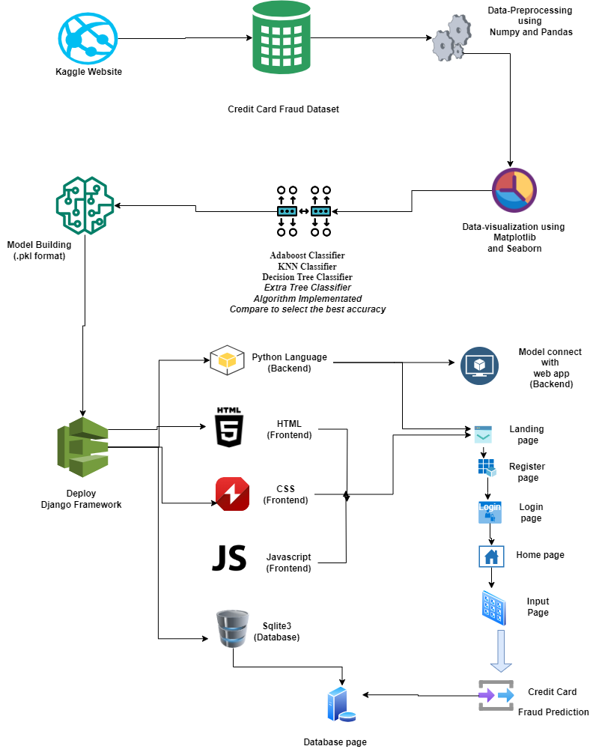
System Architecture

Slide 17
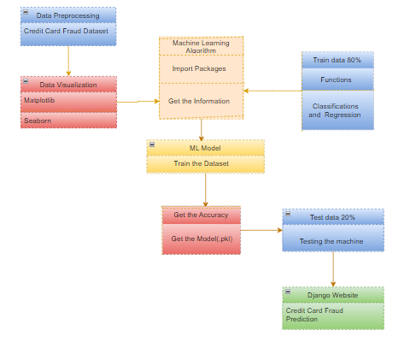
CLASS DIAGRAMS

Slide 18
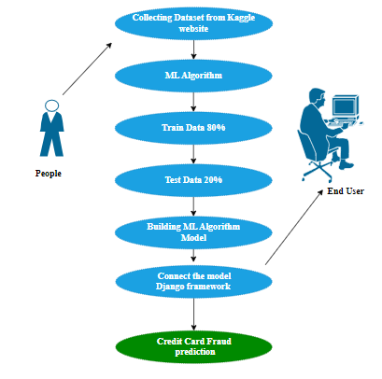
Use Case Diagram

Slide 19
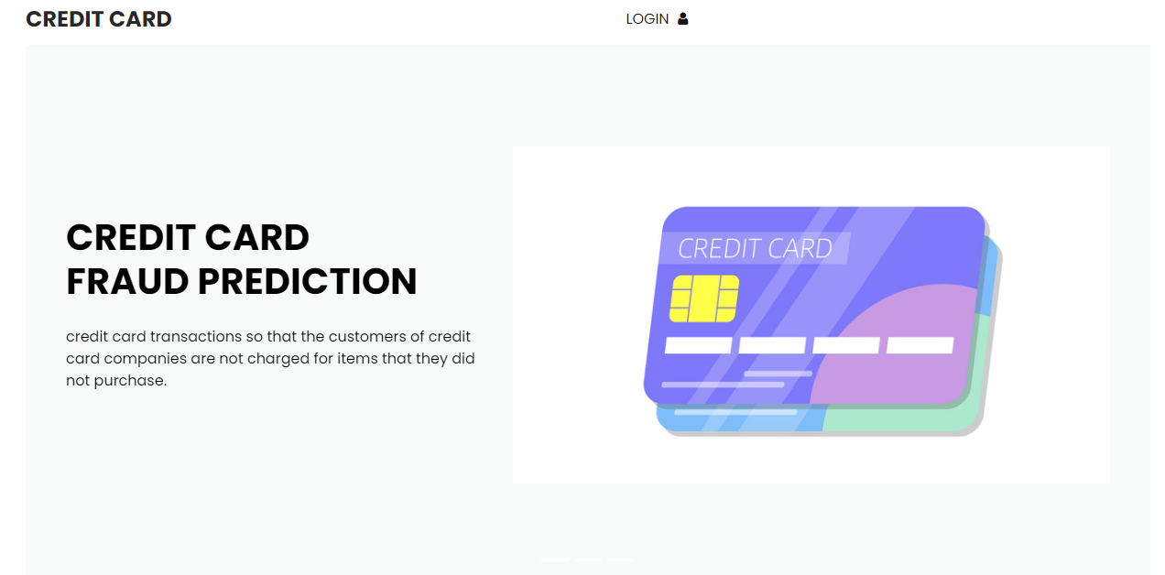
SCREEN SHOTS LANDING PAGE

Slide 20
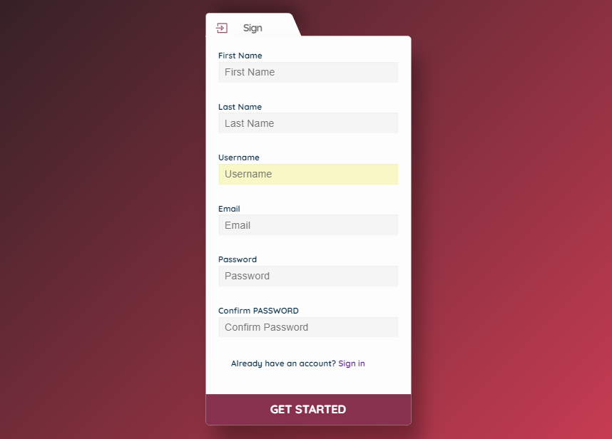
Register Page

Slide 21

Login Page

Slide 22
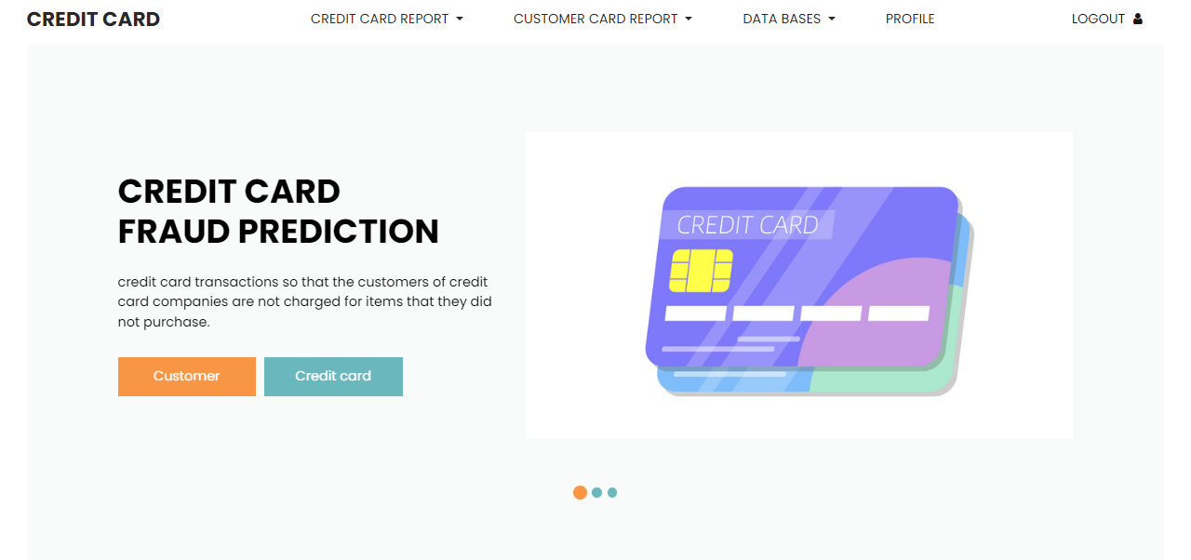
Home Page

Slide 23
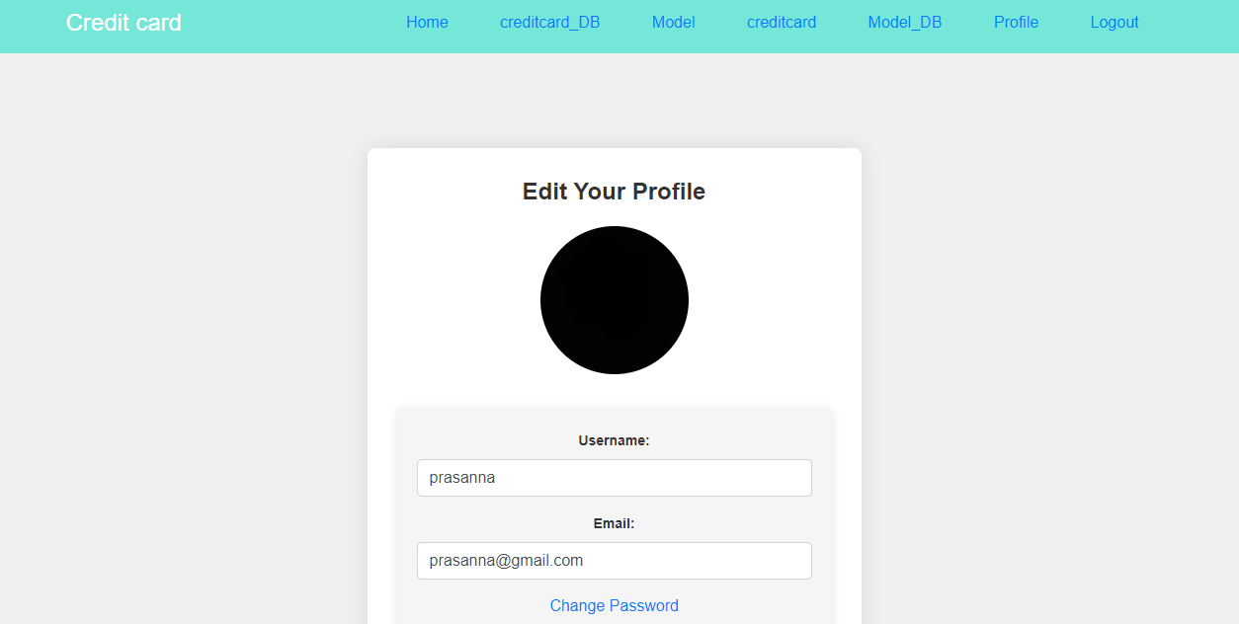
Profile Page

Slide 24
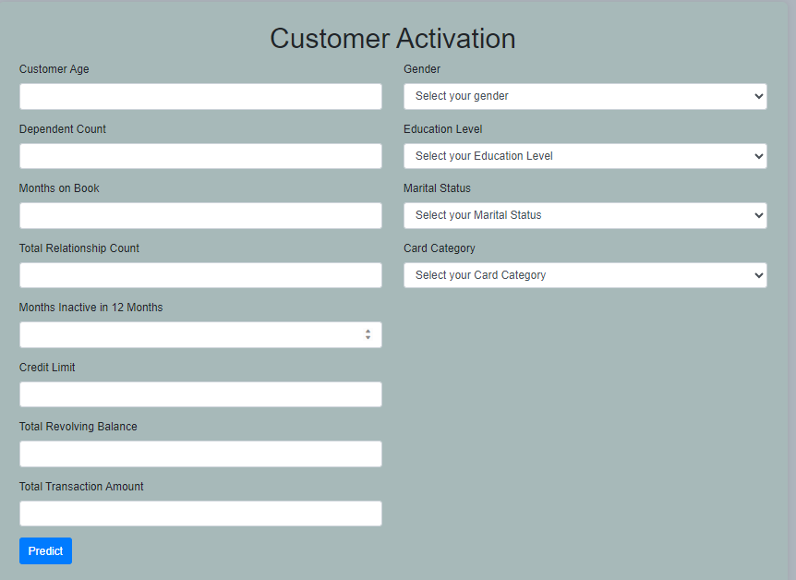
Customer Input Page

Slide 25
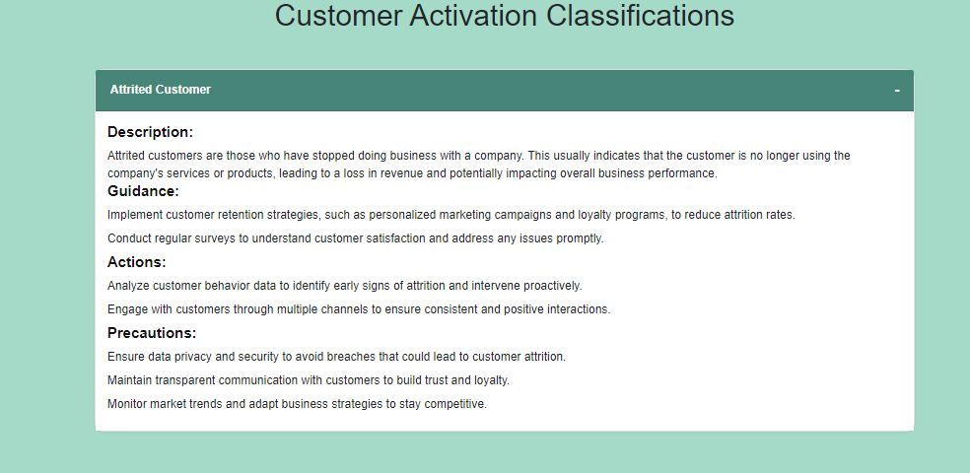
Output Page

Slide 26
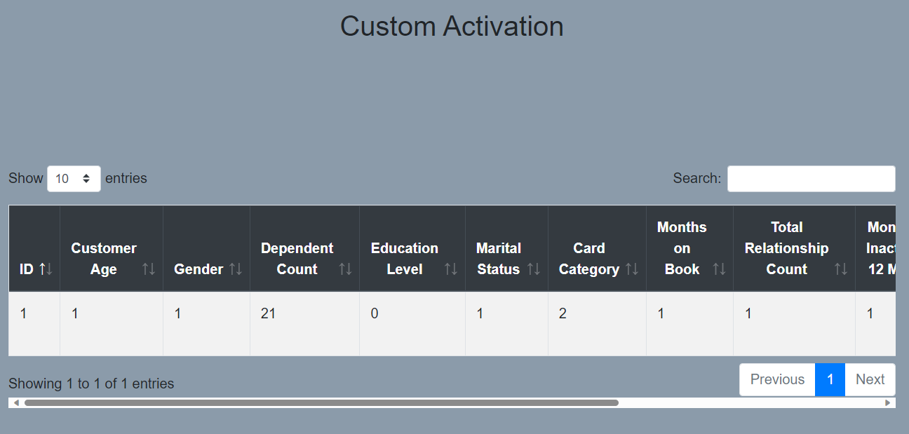
Database Page

Slide 27
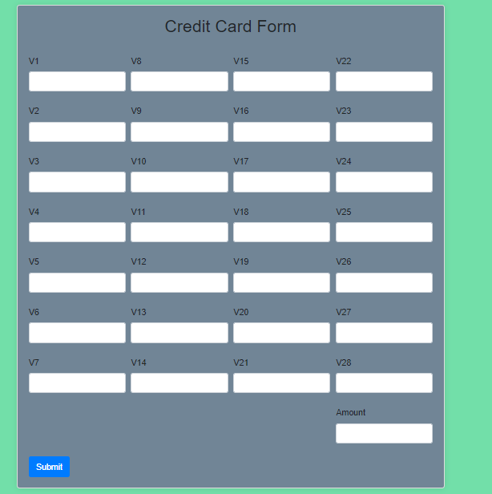
Credit Card Input Page

Slide 28
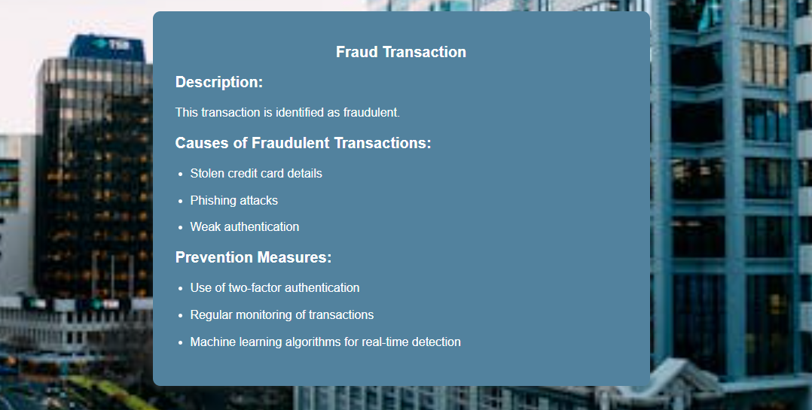
Output Page

Slide 29
Conclusion
In conclusion, encrypting credit card fraud predictions with advanced machine learning techniques represents a significant advancement in financial security. By leveraging sophisticated algorithms and encryption methods, we can enhance the accuracy and confidentiality of fraud detection systems.
Machine learning models, such as those based on deep learning and ensemble methods, can effectively identify and prevent fraudulent transactions by analyzing vast amounts of transaction data and detecting anomalous patterns. Incorporating encryption ensures that sensitive information remains protected throughout the analysis process, safeguarding against potential breaches.
Overall, this approach not only improves the reliability of fraud detection but also builds trust among users by maintaining the highest standards of data security.

Slide 30
Future Work
Prediction methods to connect with cloud model.
To optimize the work to implement in IOT System.

